Slide 1
Structural and Mechanical Properties of Polyelectrolyte Brushes
Takashi Yokokura
Advisor: Prof. Rui Wang
September 14th, 10:00 am – 12:00 pm
Qualifying Exam

Slide 2
Introduction
Polymer Brush
Chains end-fixed to some substrate
Steric interactions extend chains into solution
+
+
+
+
+
+
+
+
+
+
+
+
+
+
+
+
+
+
+
+
+
+
Polyelectrolyte Brush
Monomers contain charge
Long-range electrostatic interactions drive extension
+
+
+
+
+
+
+
+
+
+
+
+
+
+
+
+
+
+
+
+
+
+
+
+
+
+
+
+
+
Conformational possibilities
Coexistence between dilute, coil-like (vapor) layer and condensed (liquid) layer
+
+
+
+
+
+
+
+
+
+
+
+
+
+
+
+
+
+
+
+
+

Slide 3



Applications
Design and Fundamental Biology
Surface-modification
Lubrication
Anti-fouling
Surface tension
Stimuli-sensitive (smart) materials
Functionalized aggregation
Colloid-stabilization
Protein aggregation (e.g., neurofilaments)
Cell-repellant Surface
Stimuli-sensitive Brush
More specific
Abnormal NF
Chen, et al., Macromolecules, 2017 ; Srinivasan, et. al., Nat. Comm., 2014; Yuan, et. al., J. Cell Sci., 2012)
Notes:
“Design materials to solve complex problems and understand complex systems which comprise life itself”

Slide 4





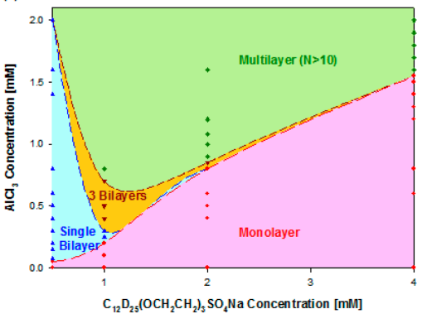
Previous Theories
Flory scaling – de Gennes, Alexander
Field theoretic
Correlation length:
No. monomers in correlation blob
Brush height
None can consider electrostatic correlations (multivalent ions)
(Rubinstein, Colby, Oxford Univ. Press, 2003; Yu, et al., Science, 2018; Xu, et al., Langmuir, 2013)

Slide 5



Outline
Model and Theory Development
SCF Eqns
Systematic Study (Solubility vs. Internal Charge)
Experimental Characterization (Reflectivity)
Experimental Application (Neurofilament-Heavy)
Future Work

Slide 6
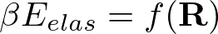
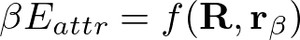


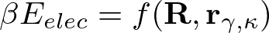



Model and Theory Development — System
What is the system made up of?
s
+
-
Interactions:
Elasticity (monomer-monomer)
Solubility (solvent-monomer)
Electrostatics (ion-monomer)
End-to-end vector
+
-
s
+
s
s
s
-
+
+
+
+
Discrete particle locations
+
+
+
-
+
s
+
s
+
-
s
+
-
s
s
+
+
s

Slide 7









Model and Theory Development— Interactions
Elastic entropy following Gaussian statistics
Flory-Huggins short-range interactions
Electrostatic correlations over Coulomb operator
Local incompressibility
Semicanonical Ensemble

Slide 8

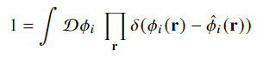


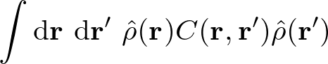



Model and Theory Development— Interactions
Particle-to-Field Transformation
111
Hubbard-Stratonovich Transformation
111
Saddle-point approximation

Slide 9

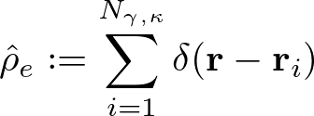

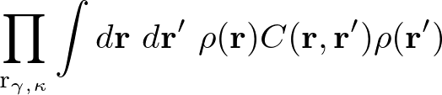
Model and Theory Development— Partition Function
Semicanonical partition function
Canonical in polymer, grand canonical in ions and solvent
Step by step
Maybe too much
fix
Particle-to-field transformations
Hubbard-Stratonovich transformation
Saddle-point approximation
Chao paper

Slide 10


Model and Theory Development — System
What is the end-result?
111
s
+
Convert from discrete particles to continuous, single-particle distributions governed by external fields.
Fields reflect coupled interactions and effect on particle distributions.
“Self-consistent field theory” (SCFT)
-
+
-
s
p
+
s
s
s
-
+
Maybe in derivation
+
+
+
+
s
+
+
+
-
+
s
+
-
111
111
+
s
-
s
+
s
−
s
+
+
s
p

Slide 11






Model and Theory Development— Free Energy
Variational Free Energy
After statistical average over grafting surface (x-y plane)
Too empty? Merge 10 and 11
Functional Minimization

Slide 12











Model and Theory Development — SCF Eqns
SCF Equations
Polymer Density:
Polymer Field:
Solvent Density:
Solvent Field:
Wording for physical meanings of fields
Incompressibility:
Monomer Probability:
(Modified Diffusion Equation)
Electrostatic Potential:
(Poisson-Boltzmann Equation)

Slide 13
Outline
Model and Theory Development
Systematic Study (VdW Attraction vs. Electrostatic Repulsion)
s
s
s
s
s
s
s
+
+
+
s
+
+
+
+
+
+
+
s
Solubility
(VdW attraction)
s
s
s
Z axis
Attractive
Repulsive
Experimental Characterization (Reflectivity)
Experimental Application (Neurofilament-Heavy)
Future Work
Polymer charge fraction
(Electrostatic repulsion)

Slide 14



Solubility sweep, $α$ = 0.40, cont.
Don’t say solubility (hydrophobic interactions)
System:
Different font family for labels (look sharp)
Redundant, maybe first when showing what you’re doing
Summary line on every slide

Slide 15










Varying VdW ($χ$) at const. Electrostatic ($α=0.40$)
System:
Height
“condensed”, not C
Titles, label conformations
(nm)
Phase coex
Z axis
Metastable, make first
0
Legend?
0
0
“phase transition”

Slide 16


Solubility at Different Internal Charges
Don’t say solubility (hydrophobic interactions)
System:
Observations and key points
* Why they are expected, what do they mean
Segmented, fix a020 file, chi attr and alpha repulsion

Slide 17




Internal Structure of xC conformations
Change
Two candidates with identical averaged density profiles
2C
Label solid vs dashed
Only one yields correct endpoint distributions
4Cd
“Locked-in-layer”
“Pearl-necklace-like”
(Endpoint densities x 30)

Slide 18

Outline
Model and Theory Development
Systematic Study (Solubility vs. Internal Charge)
Internal Structure of xC
Experimental Characterization (Reflectivity)
Not accurate
Experimental Application (Neurofilament-Heavy)
Cooperative Collapse of the Dilute Layer
Future Work

Slide 19



Reflectivity — Method
Validate results by finding layered structures in PEBs
X-ray or neutron reflectivity for characterization of layered films
Merge next slide here
Specular part of wave scattering vector
Master Equation: Relates density changes to scattering vector
(Schreiber, n.d.)

Slide 20


Reflectivity — Characteristic Spectra
X-ray and neutron reflectivity
Direct information on polymer internal structure
Prior knowledge of possible conformations necessary
Master Equation
(Reinhardt, et. al. Macromolecules, 2013)

Slide 21

Outline
Model and Theory Development
Systematic Study (Solubility vs. Internal Charge)
Internal Structure of xC
Experimental Characterization (Reflectivity)
Experimental Application (Neurofilament-Heavy)
Not accurate
“… AQGEEEEEAEEGGEEAATTSPPA …”
(Srinivasan, 2014)
“Heavy”
(Yuan, 2012)
Future Work

Slide 22




Method of Coarse-graining Protein Charge Distribution
Simplifying protein charge distribution is non-trivial
A straight-forward method is to monitor the cumulative sum (cusum)
Sample sequence:
HHHHHHHHHHHHHHH DDDDDDDDDDDDDDDDDDDDDDDDDDDDDD KDDDHHK KDDDHHK KDDDHHK KDDDHHK KDDDHHK KDDDHHK KDDDHHK KDDDHHK KDDDHHK KDDDHHK
incomplete

Slide 23



Application to NFH, pH 2.4
Merge with previous

Slide 24



Cooperative Collapse of the Dilute Phase
What changes are occurring within NFH during 3x decrease?
Dramatic collapse
2Cd
2C
1C
“Cooperative collapse”
Too many
Summary line

Slide 25
Summary
SCFT considering…; using that, these phenomena
xC conformations exist at high internal repulsion
Characteristic reflectivity spectra can be generated rigorously
Feedback from group meeting
Each chain in xC(d) “locked-in-layer”
NFH dramatic collapse caused by cooperative interactions

Slide 26
Outline
SCFT Build-up
Systematic Study (Solubility vs. Internal Charge)
Internal Structure of xC
Experimental Characterization (Reflectivity)
Experimental Application (Neurofilament-Heavy)
Cooperative Collapse of the Dilute Layer
Future Work

Slide 27
Future Work
xC extension:
Response to foreign species (e.g. spherical tip of AFM)
Response to brush-brush
Multivalent ions (ion correlations)
Experimental Collaborations
Validation with reflectivity
NF(L/M/H) blends for study of biological neurofilaments
Erika Ding, Prof. Sanjay Kumar
Nafion aggregation using SCFT-generated force fields and MD
Siddarth Rajupet, Prof. Clayton Radke
Much more specific; physics /interactions of each problem
Highlight difficult problem and not that it’s a collaboration
What is your planned contribution

Slide 28






Acknowledgements
Wang Group
Prof. Rui Wang
Dr. Chao Fang
Luofu Liu
Nikhil Agrawal
Dr. Chao Duan

Slide 29
Summary
Paste from above when finished

Slide 30
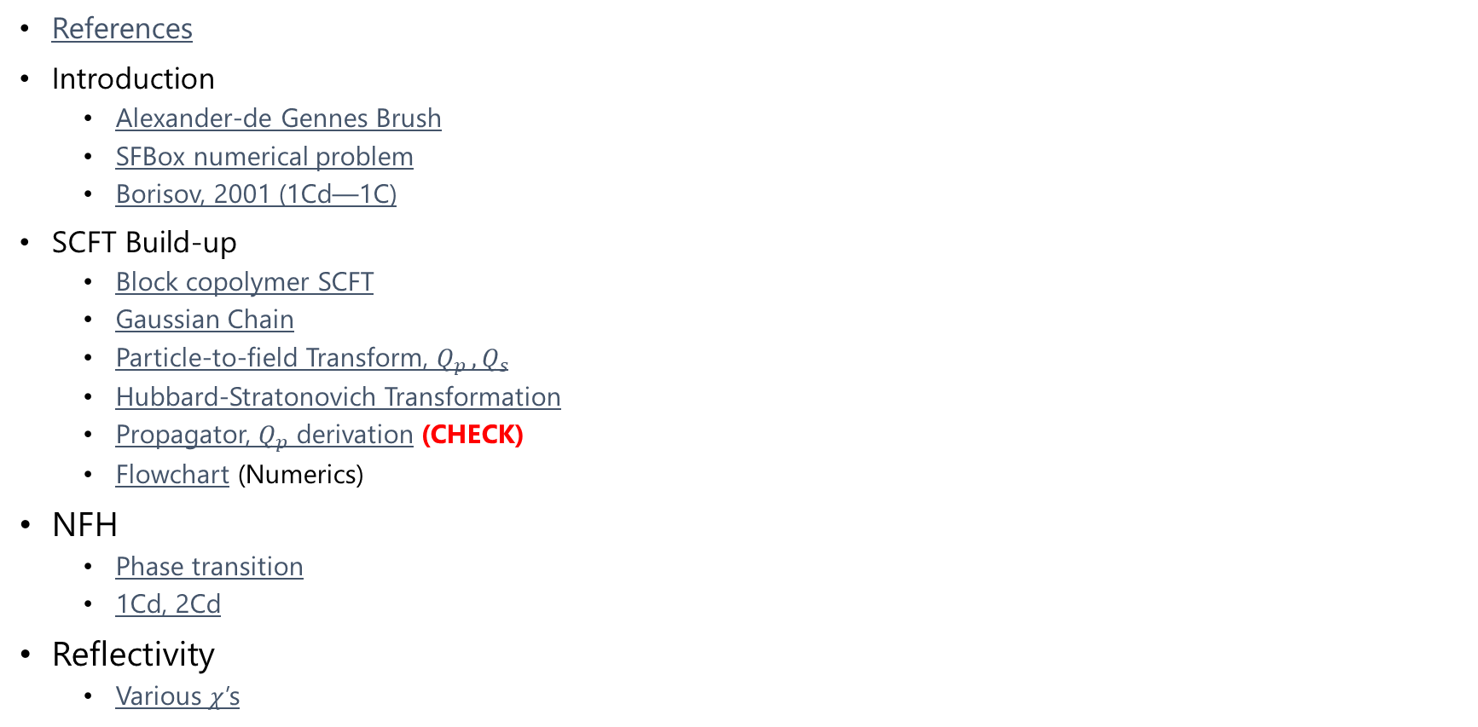
SI: Table of Contents
References
Introduction
Alexander-de Gennes Brush
SFBox numerical problem
Borisov, 2001 (1Cd—1C)
SCFT Build-up
Block copolymer SCFT
Gaussian Chain
Particle-to-field Transform, $Q_{p }, Q_{s}$
Hubbard-Stratonovich Transformation
Propagator, $Q_{p}$ derivation (CHECK)
Flowchart (Numerics)
NFH
Phase transition
1Cd, 2Cd
Reflectivity
Various $χ$’s

Slide 31
References
Abnormal NF image: Yuan, A., Rao, M. V., Veeranna, & Nixon, R. A. (2012). Neurofilaments at a glance. Journal of Cell Science, 125(14), 3257–3263. https://doi.org/10.1242/jcs.104729
Height Profile Figure: Srinivasan, N., Bhagawati, M., Ananthanarayanan, B., & Kumar, S. (2014). Stimuli-sensitive intrinsically disordered protein brushes. Nature Communications, 5(1), 5145. https://doi.org/10.1038/ncomms6145
Alexander-de Gennes Brush: Rubinstein, M., & Colby, R. H. (2003). Polymer Physics, Oxford University Press. New York.
Lubricity Figure: Yu, J., Jackson, N. E., Xu, X., Morgenstern, Y., Kaufman, Y., Ruths, M., de Pablo, J. J., & Tirrell, M. (2018). Multivalent counterions diminish the lubricity of polyelectrolyte brushes. Science, 360(6396), 1434–1438. https://doi.org/10.1126/science.aar5877
XR Multilayer Figure: Xu, H., Penfold, J., Thomas, R. K., Petkov, J. T., Tucker, I., & Webster, J. P. R. (2013). The Formation of Surface Multilayers at the Air–Water Interface from Sodium Polyethylene Glycol Monoalkyl Ether Sulfate/AlCl ₃ Solutions: The Role of the Size of the Polyethylene Oxide Group. Langmuir, 29(37), 11656–11666. https://doi.org/10.1021/la4030348
Anti-Biofouling Figure: Chen, W.-L., Cordero, R., Tran, H., & Ober, C. K. (2017). 50th Anniversary Perspective: Polymer Brushes: Novel Surfaces for Future Materials. Macromolecules, 50(11), 4089–4113. https://doi.org/10.1021/acs.macromol.7b00450
XR Layout Figure: Schreiber, F., & Gerlach, A. (n.d.). X-Ray and Neutron Reflectivity. Department of Chemistry - University of Oxford. www.physchem.ox.ac.uk/~fs
XR Spectra Figure: Reinhardt, M., Dzubiella, J., Trapp, M., Gutfreund, P., Kreuzer, M., Gröschel, A. H., Müller, A. H. E., Ballauff, M., & Steitz, R. (2013). Fine-Tuning the Structure of Stimuli-Responsive Polymer Films by Hydrostatic Pressure and Temperature. Macromolecules, 46(16), 6541–6547. https://doi.org/10.1021/ma400962p

Slide 32




Alexander-de Gennes Brush
Monomers in correlation blobs (self-avoiding walk)
Height = Correlation length x No. Correlation blobs
“Correlation length”
Rubinstein, M., & Colby, R. H. (2003). Chapter 5.3

Slide 33


Borisov previous theory
Klushin, Birshtein, Amoskov. (2001). Macromolecules, 34.

Slide 34

SFBox Lattice Artifacts
Pryamitsyn, V. A., Leermakers, F. A. M., Fleer, G. J., & Zhulina, E. B. (1996). Macromolecules, 29(25), 8260–8270.

Slide 35

Block copolymer Free Energy, SCF Eqns
Variational Free Energy
After statistical average over grafting surface (x-y plane)
Functional Minimization
SCF Equations

Slide 36


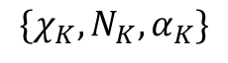
Block copolymer PDEs
Mean-field Poisson-Boltzmann Equation
Modified Diffusion Equation
Block K
$$\{χ_{K},N_{K}, α_{K}\}$$
Block 2
Block 1

Slide 37





SCFT Build-up — Flowchart
PDE Solve (for iteration k)
Propagate (using PDE solutions)
Check (for self-consistency)
Update (if not satisfied)
Anderson Mixing
Simple Mixing
Notation slightly incorrect but changed for clarity. w^{k} = f(w^{k+1/2}, w^{k-1}), where w^{k+1/2} is from SCFT calculations (\phi remains ^{k})

Slide 38











Gaussian Chain
Probability of R with N
Bond vector distribution
Local Fluctuation
Generalize to whole chain with free internal segments
Large N, kb << 1
Configurational integral with free ends

Slide 39



Particle-to-Field Transform

Slide 40
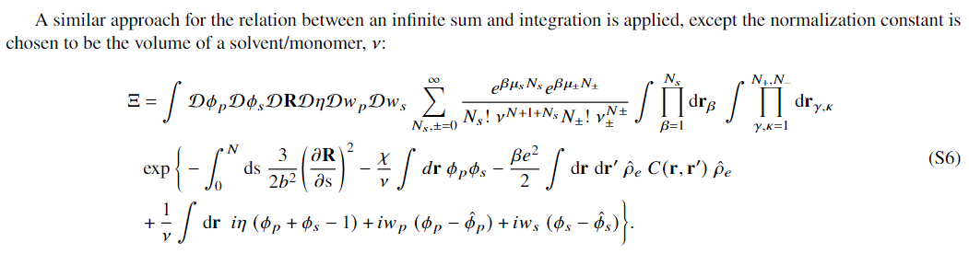


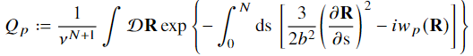
Particle-to-Field Transform (2)
Cancels out

Slide 41
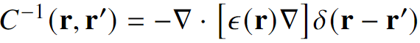
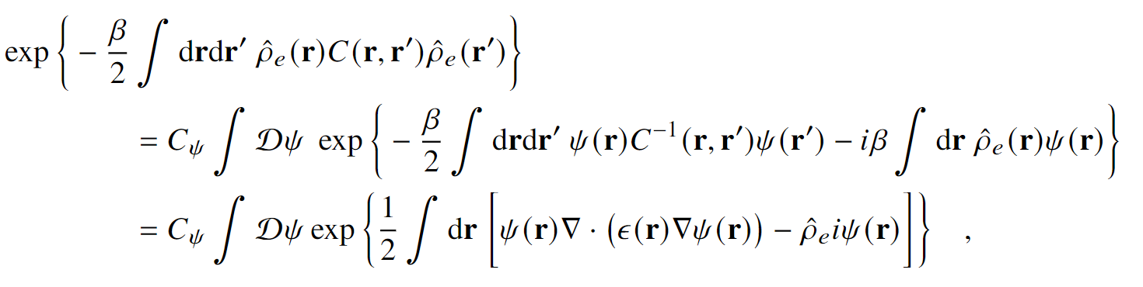
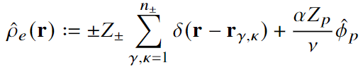
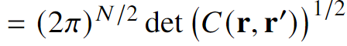
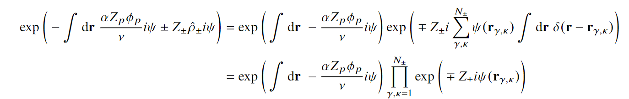
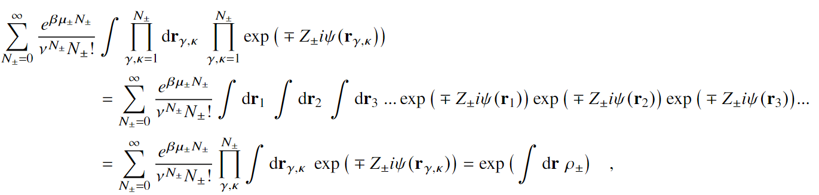
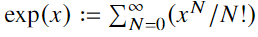
Hubbard-Stratonovich Transformation
Constant, ignored
Electrolyte GCE

Slide 42




Propagator notation

Slide 43


Reflectivity — Different $χ$’s

Slide 44

NFH Phase Transition

Slide 45

NFH 1Cd, 2Cd

